Slide 1

Capstone Project-3
Cardiovascular Risk Prediction
Prepared By
Nitin Solanki (solankinitin1210@gmail.com)

Slide 2
Points of discussion
Problem Statement
To know the Dataset
Handling Null values and Outliers
Do EDA on the Dataset
Check Correlation
Deal With Categorical Columns and Class Imbalance
Prepare Data for ML Model
Run Different ML Model
Score Board
Model Explainability
Conclusion

Slide 3
Problem Statement
Cardiovascular disease is the leading cause of death worldwide and a major public health concern. Therefore, its risk assessment is crucial to many existing treatment guidelines.
Risk estimates are also being used to predict the magnitude of future cardiovascular disease mortality and morbidity at the population level and in specific subgroups to inform policymakers and health authorities about these risks.
We have been given a dataset from an ongoing cardiovascular study on residents of the town of Framingham, Massachusetts that provides the patients’ information
It includes over 3,000 records and 15 attributes. Each attribute is a potential risk factor. There are both demographic, behavioral, and medical risk factors.
The classification goal is to predict whether the patient has a 10-year risk of future coronary heart disease (CHD).

Slide 4
To Know Our Dataset
Initial observations for the given dataset are
The dataset provides the patients’ information. It includes over 3390 records and 17 attributes. Each attribute is a potential risk factor. There are both demographic, behavioral, and medical risk factors.
Some Columns are contained null values (For an example Education, cigsPerDay , BPMeds , BMI, heartrate, glucose)
Data contained in every column are in the required datatype.
Out of 17 columns, 6 Columns contain the numeric data and 11 columns contain categorical data
Our Dependent/Target variable is "TenYearCHD", rest are Independent variable
Our target variable contains the categorical data so our approach will be a classification model of machine learning.
Let’s Check all the variables in detail

Slide 5
Problem Statement
Attribute Information:
Demographic
Sex : male or female("M" or "F")
Age: Age of the patient (Continuous)
Behavioral
is_smoking: whether or not the patient is a current smoker ("YES" or "NO")
Cigs Per Day: the number of cigarettes that the person smoked on average in one day.(Continuous)
BP Meds: whether or not the patient was on blood pressure medication (Nominal)
Prevalent Stroke: whether or not the patient had previously had a stroke (Nominal)
Prevalent Hyp: whether or not the patient was hypertensive (Nominal)
Diabetes: whether or not the patient had diabetes (Nominal)
Tot Chol: total cholesterol level (Continuous)
Sys BP: systolic blood pressure (Continuous)
BMI: Body Mass Index (Continuous)
Heart Rate: heart rate (Continuous)
Glucose: glucose level (Continuous)
Predict variable (desired target)
10-year risk of coronary heart disease CHD(binary: “1”, means “Yes”, “0” means “No”)

Slide 6
Variable Description
Sr. | Variable | Null Values | Data Type
1 | id | 0 | Integer
2 | age | 0 | Integer
3 | education | 87 | float
4 | sex | 0 | object
5 | is_smoking | 0 | object
6 | cigsPerDay | 22 | float
7 | BPMeds | 44 | float
8 | prevalentStroke | 0 | Integer
9 | prevalentHyp | 0 | Integer
10 | diabetes | 0 | Integer
11 | totChol | 38 | float
12 | sysBP | 0 | float
13 | diaBP | 0 | float
14 | BMI | 14 | float
15 | heartRate | 1 | float
16 | glucose | 304 | float
17 | TenYearCHD | 0 | Integer

Slide 7
Preparing the dataset for EDA
Clean data and Deal with null values
Id columns do not contain any useful information so it's not required for our analysis
As we know that heart disease has no relation to education, so the education column is again not required in analysis (even in the given PDF document this column is not mentioned)
Variable cigsPerDay, totChol, BMI, glucose, heartrate, BPMeds Contain the Null values
Out of these variables cigsPerDay, totChol, BMI, glucose, heartrate are contains the numerical values and BPMeds contains the categorical values
After plotting the data distribution chart for the numerical variable it’s been observed that all the of those charts are somewhat positively skewed and from the box plot it concluded that it contains some outliers so I replace the null values with the median of the data
BPMeds contain the categorical data (as it only contains 0 & 1) so, the null value will be replaced with the mode of the data
2. Deal with Outliers
Variables cigsPerDay, totChol, BMI, glucose, heartrate, sysBP Contain outliers
Here instead of removing the outliers I choose to use winsorizing method to convert outlier to lower or upper limit value
IQR methods have been used to find the outliers, all the data points below the IQR-1.5 and above the IQR+1.5 are considered an outlier
Once outlier are detected and same has been replaced with a lower limit or upper limit

Slide 8

Now we will explore our data by selecting some categorical variable and plot a chart for categorical variable v/s Target variable, we’ll do an analysis for below listed variable
TenYearCHD
Is_Smoking
sex
Diabetes
Bpmeds
PrevalentStroke
PrevalentHyp
So Let’s Start our EDA

Slide 9
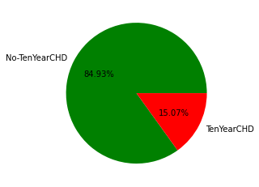
TenYearCHD
In the given data set 3390 Patient records are given, out of those 511(15.07%) Patients have the risk of cardiovascular and the rest 2879(84.93%) patients have no risk of cardiovascular
This is clearly shows that data is imbalanced

Slide 10
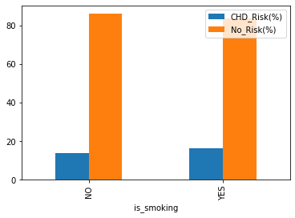
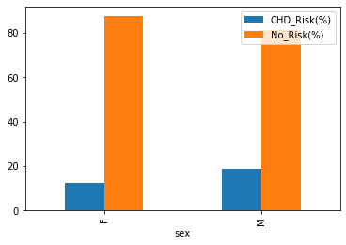
Gender wise Analysis
Smoking wise Analysis
Smoker have 16.30% chance to have the risk of cardiovascular whereas Non-Smoker having 13.86% chance of have risk of cardiovascular
Smoker person have more risk compared to Non-Smoker
Male patients have 18.54% chance to have a risk of cardiovascular whereas female patients have 12.43% chance of having a risk of cardiovascular
Male patients have more risk compared to female

Slide 11
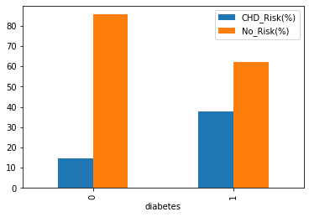
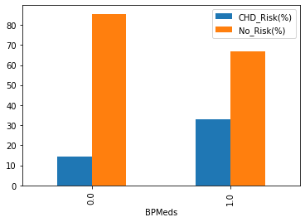
BPMeds wise Analysis
Diabetes wise Analysis
Diabetic patients have 37.93% chances to the have risk of cardiovascular where Non- Diabetic have 14.47% chance of having risk of cardiovascular
Diabetic people have more risk compared to Non- Diabetic
Patients with blood pressure medication have 33% chance to have risk of the cardiovascular whereas patients without blood pressure medication have 14.53% chance of having risk of cardiovascular
Patients with blood pressure medication has more risk compared to Patients without blood pressure medication

Slide 12
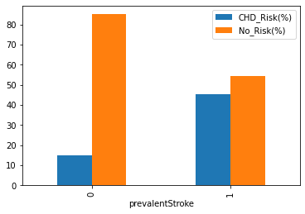
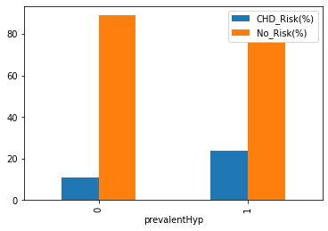
PrevalentHyp wise Analysis
PrevalentStroke wise Analysis
Patient had previously had a stroke have 45.45% chances to have risk of cardiovascular where patient had not previously had stroke have 14.88% chance of have risk of cardiovascular
Patient had previously had a stroke have more risk of cardiovascular
Hypertensive patient have 23.85% chances to have risk of cardiovascular where Non- Hypertensive patient have 11.03% chance of have risk of cardiovascular
Hypertensive patient have more risk of cardiovascular compare to Non- Hypertensive patient

Slide 13
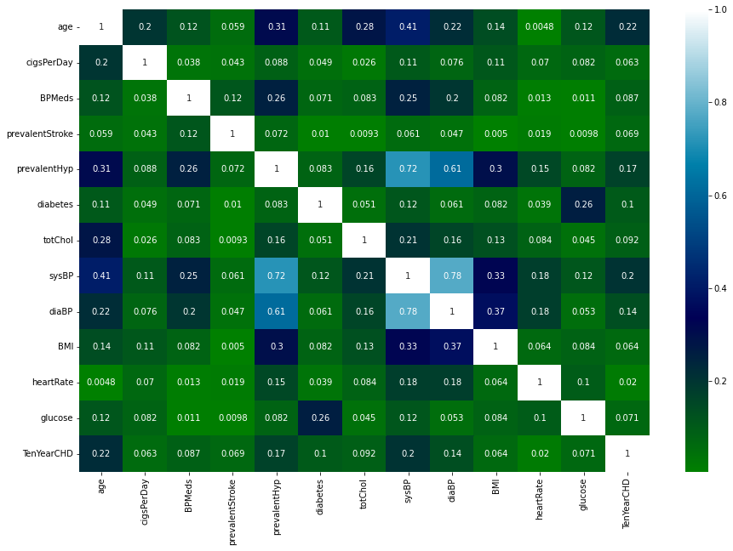
Correlation
It’s observed from the heat map that age and sysBP have higher correlation with dependent variable, compare to other variable
It’s also observed that some independent variables are internally correlated for example sysBP is highly correlated with prevalentstroke.

Slide 14
Deal With Categorical Data
It is crucial to handle categorical data during the pre-processing phase, as in the data having 6 categorical features, namely sex, is_smoking, BPMeds, prevalentStroke, prevalentHyp, diabetes
Machine learning can seldom deal with categorical data. So it need to convert these categorical data to numeric data and to do so we have used On-Hot Coding
Two separate columns will be created for all these 6 variables so total 12 columns will be added and original columns will be removed from dataset
In rare cases like this disease prediction, it is vital to identify the minority classes correctly. So model should not be biased to detect only the majority class but should give equal weight or importance to the minority class too.
Here SMOTE techniques have been used to overcome this issue, SMOTE Simply adds duplicate records of minority class and often doesn’t add any new information to the model.
SMOTE has created 2368 new records and updated dataset have 5758 records.
Deal With Class Imbalance

Slide 15
Preparing the dataset for ML
Now when we have done our EDA, and added the required columns to our dataset, before we feed it to ML model, need to declare some important points
1. Declare our X and Y
In our data set all the variables except “TenYearCHD” will be our X-Independent Variables and “TenYearCHD” will be our Y-Dependent variable
2. Training and Testing Data set
To train our models and then after training, to test the performance we have split our dataset into 2 parts, training and testing dataset
We kept a ratio of 75:25 in splitting, so our 75% of data (4318 Rows) will be used to train the model and 25% of data (1440 Rows) will be used to test the model
3. Standardize Dataset
it is Important that our dataset is in standardized format to get the optimum result so to standardize independent variables we have used the function StandardScaler()

Slide 16
4. Measurement Parameter
To measure the performance of the ML model we’ll use
Accuracy
Precision
Recall
F1 score
Roc score
Here we are working on medical data and predicting the cardiovascular risk before it happen so that, it can be treated and prevented to happen hence we must predict a higher correct number of positive case
A false positive can lead to unnecessary treatment and a false negative can lead to a false diagnosis, which is very serious since disease has been ignored. So in our case recall measurement parameter is very important than other parameters.
So, the model which gives us the best recall score will be our best predictor model

Slide 17

Now When we have everything we need, let's start creating ML models. We‘ll create below listed models
Logistic Regression
Support Vector Classifier
K Nearest Neighbour
Decision Tree
Random Forest
Gradient Bosting
Extreme gradient boosting
Stacking
Let’s Run ML Models

Slide 18
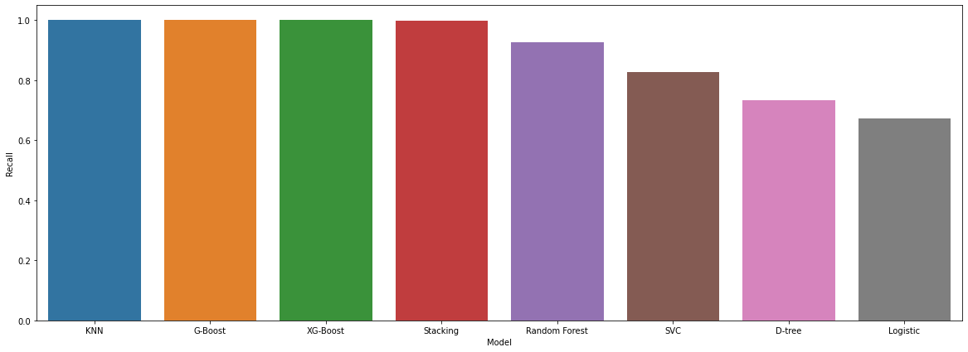
Train Score Board
Model | KNN | G-Boost | XG-Boost | Stacking | Random Forest | SVC | D-tree | Logistic
Accuracy | 1 | 1 | 1 | 0.998 | 0.954 | 0.870 | 0.785 | 0.792
Precision | 1 | 1 | 1 | 0.998 | 0.981 | 0.906 | 0.821 | 0.885
Recall | 1 | 1 | 1 | 0.999 | 0.927 | 0.827 | 0.733 | 0.674
F1_Score | 1 | 1 | 1 | 0.998 | 0.953 | 0.865 | 0.775 | 0.765
Roc_Score | 1 | 1 | 1 | 0.998 | 0.954 | 0.870 | 0.785 | 0.793

Slide 19
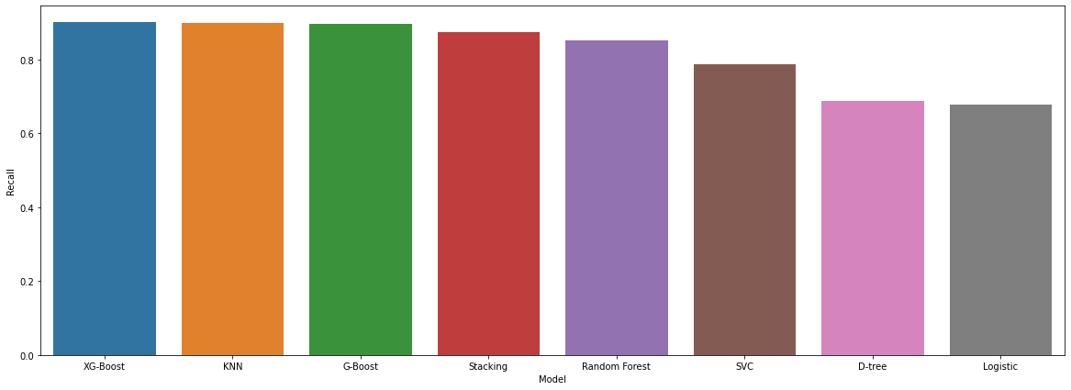
Test Score Board
Model | XG-Boost | KNN | G-Boost | Stacking | Random Forest | SVC | D-tree | Logistic
Accuracy | 0.912 | 0.864 | 0.905 | 0.908 | 0.874 | 0.818 | 0.738 | 0.794
Precision | 0.918 | 0.835 | 0.908 | 0.933 | 0.886 | 0.832 | 0.755 | 0.872
Recall | 0.901 | 0.899 | 0.896 | 0.875 | 0.851 | 0.787 | 0.688 | 0.678
F1_Score | 0.909 | 0.866 | 0.902 | 0.903 | 0.868 | 0.809 | 0.720 | 0.763
Roc_Score | 0.912 | 0.865 | 0.905 | 0.908 | 0.873 | 0.817 | 0.737 | 0.791

Slide 20
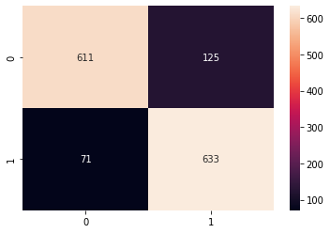
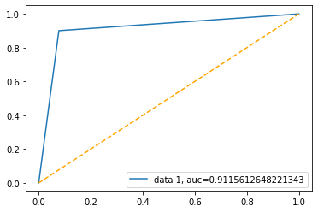
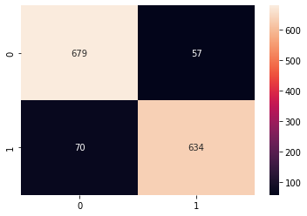
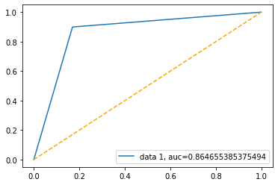
Confusion Matrix and ROC Curve
K Nearest Neighbour
Extreme gradient boosting

Slide 21
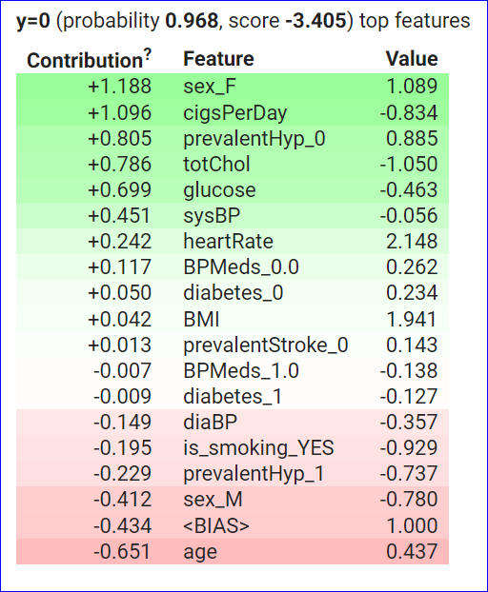
Model Explainability
For XG Boost
ELI5 was coded to check the model explainability and a table were obtained for the second row in the dataset.
We can observe, for our selected data point (2nd row) Gender has the most significant effect on the final prediction.
This process can be checked on any data point on the dataset in a similar way.

Slide 22
Challenges
We noticed that some columns in the dataset contain the outliers so outlier treatment was necessary, We found the outliers using the IQR method and then instead of removing we use winsorising technique to covert them, considering the size of data If we choose to remove them it will create more class imbalance in data
Data had class imbalanced with the dependent variable and to avoid biased prediction it was important to deal with this issue and to overcome this problem SMOTE technique was used
There were many columns were containing the null value and it was a big challenge to deal with these data points without removing them, after plotting the distribution chart according to observation null values were replaced with median/mode of data
As Multiple models were run along with cross-validation and hyperparameter tuning, computational time was quite high. Gradient boosting and extream gradient boosting had the highest computational time

Slide 23
Conclusion
Machine Learning algorithm K-Nearest Neighbour, Gradient boosting and XG Boosting performed the best with a recall of 1.0 on the train data set
KNN and Gradient boosting performed the best on test data with a recall score of 0.89 and 0.90 respectively
Logistic Regression is the least accurate as compared to other models performed.
Model explainability was performed on extrema gradient boosting using eli5 and it’s observed that sex(gender) has the most significant impact on the target variable whether the patient will have the risk of CHD or not.
Model can be improved with more computational resources and with more data.

Slide 24
Thank You

